Slide 1
Python Libraries for Cybersecurity
Drew Wilson

Slide 2
Miscellaneous
Base64
cryptography
Encoding and decoding base64 encoded strings
Part of standard library
Implements and works with cryptographic functions
pip3 install cryptography
pathlib
Object-Oriented cross-platform path library for file manipulation
pip3 install pathlib

Slide 3
Scraping
BeautifulSoup
requests
Parsing and manipulating HTML
pip3 install beautifulsoup4
from bs4 import BeautifulSoup
Making HTTP requests
pip3 install requests
MechanicalSoup
scrapy
Automating interaction with websites
pip3 install MechanicalSoup
Web crawling and scraping
pip3 install Scrapy

Slide 4
System
sys
os
Provides system-specific functions
Part of standard library
Provides functions for interacting with the operating system
Part of standard library
socket
Reading and writing to sockets (useful for netcat)
Part of standard library

Slide 5
Security
Scapy
setoolkit
Crafting and sending custom packets
pip3 install scapy
from scapy.all import *
Social engineering tools
git clone https://github.com/trustedsec/social-engineer-toolkit/ setoolkit/
cd setoolkit
pip3 install -r requirements.txt
sqlmap
Automated SQL injection testing
pip3 install –upgrade sqlmap

Slide 6
Example - World Wide Web (CSAW Qualifiers)

Slide 7
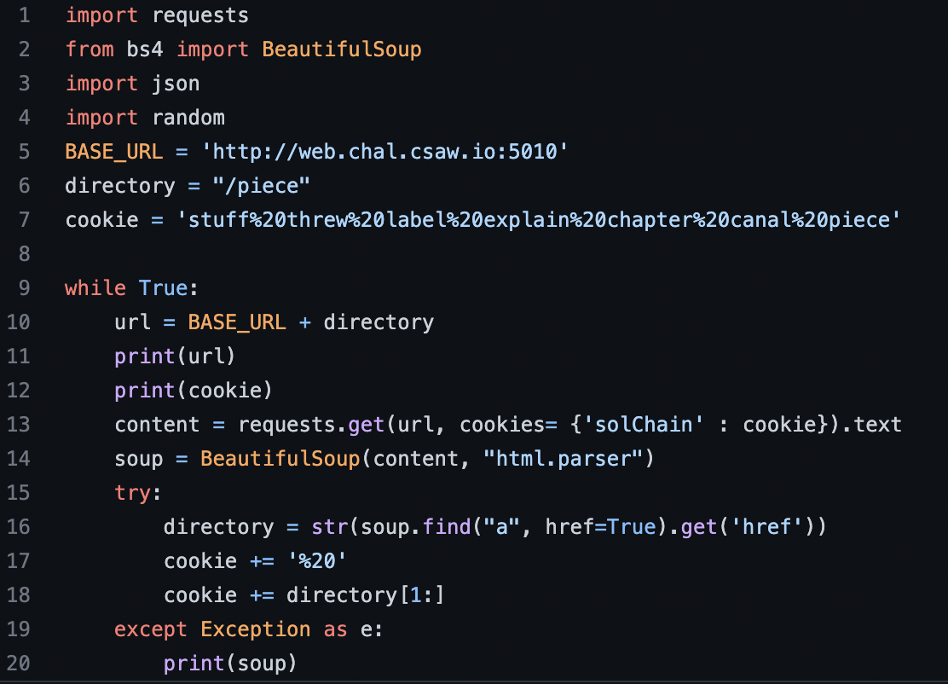
Challenge
Solution
Page with hundreds of <a> tags
Only one hyperlinked
Dozens of pages deep
Request page
Find link
Add to cookie
Repeat

Slide 8
Challenge – Scripted Netcat Addition

Slide 9
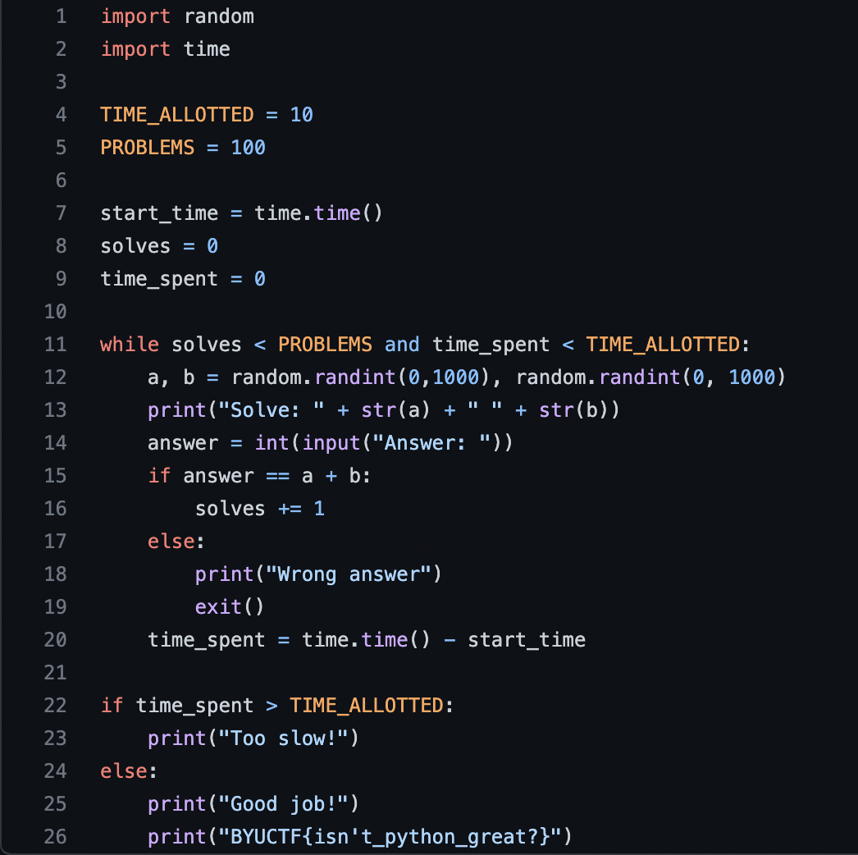
Challenge
nc drewwilson.guru 40001
Solve 100 addition problems in 10 seconds

Slide 10
Tips
nc drewwilson.guru 40001
Socket library useful functions:
socket
connect
recv
decode
send
bytes
Or a better way - the PWN library
remote
recvline
decode
sendline
encode

Slide 11
References / Resources
https://github.com/kahuku/CTF-code
https://github.com/vinta/awesome-python

